Slide 1


How to use the Canva Toolkit
Catholic SistersWeek 2024
Resource Walk-Through

Slide 2
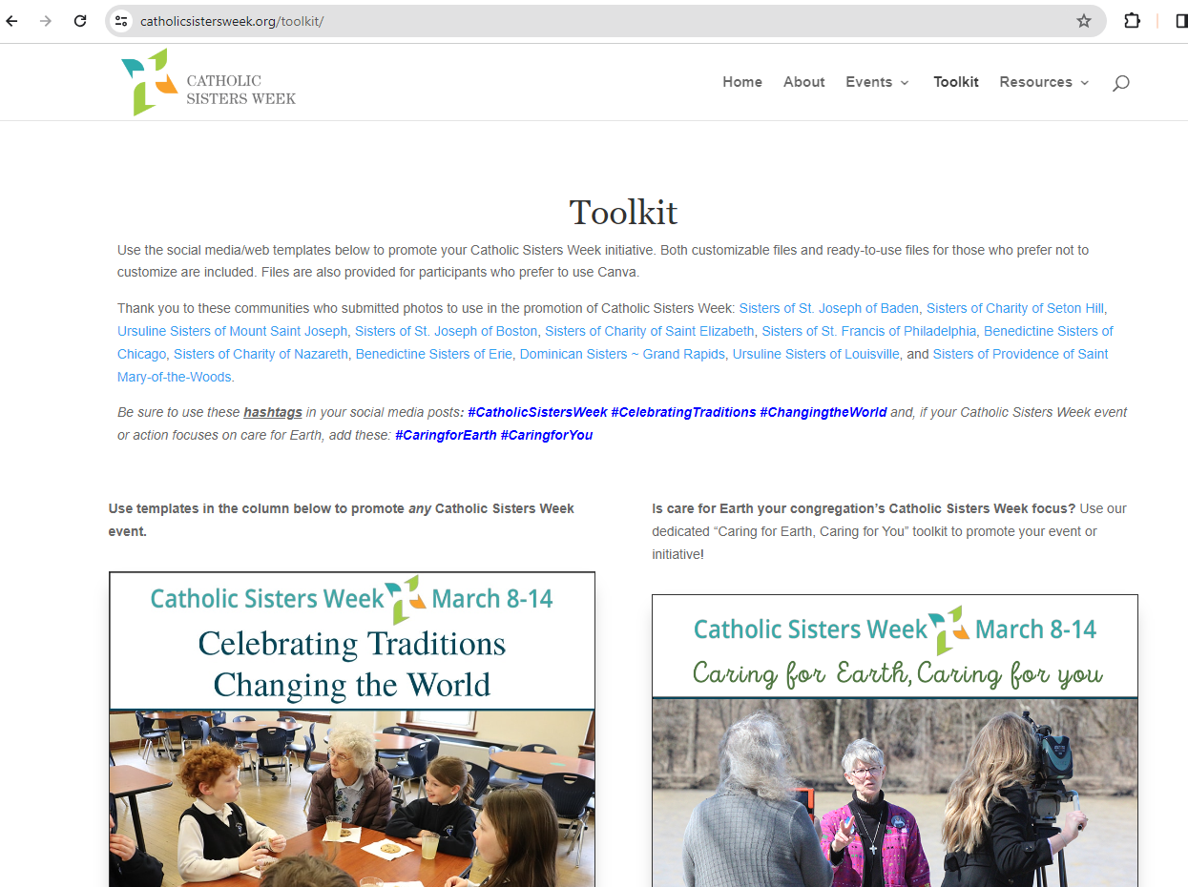
1
Start by visiting the Toolkit page on the CSW website.
Link:
Catholic Sisters Week Toolkit

Slide 3
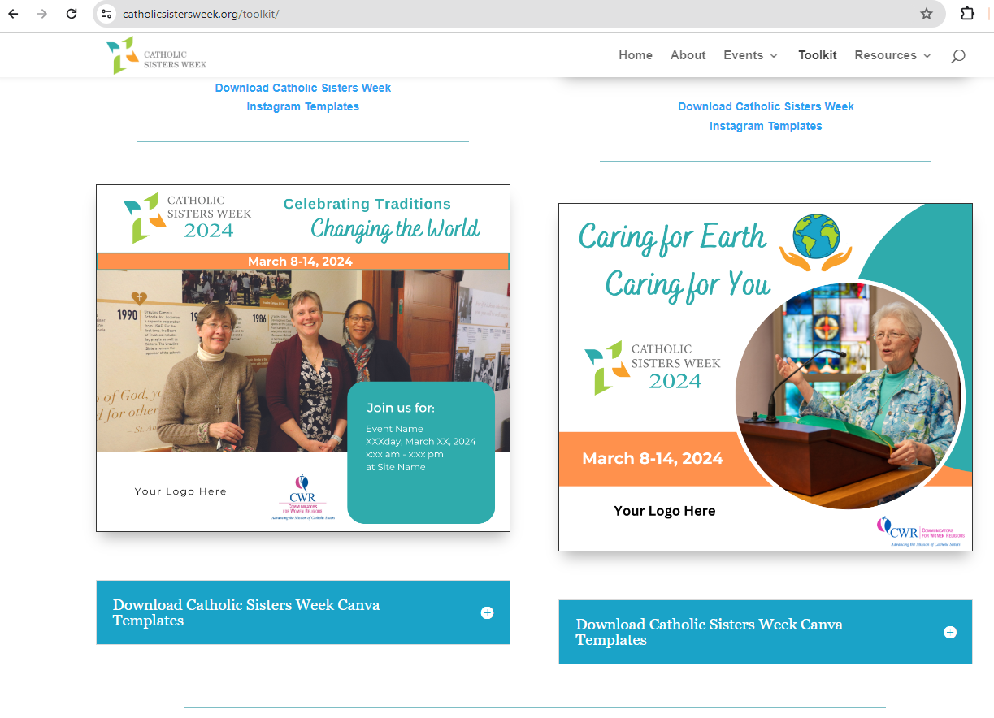

2
Scroll down to the bottom of the page, and locate the blue boxes.

Slide 4
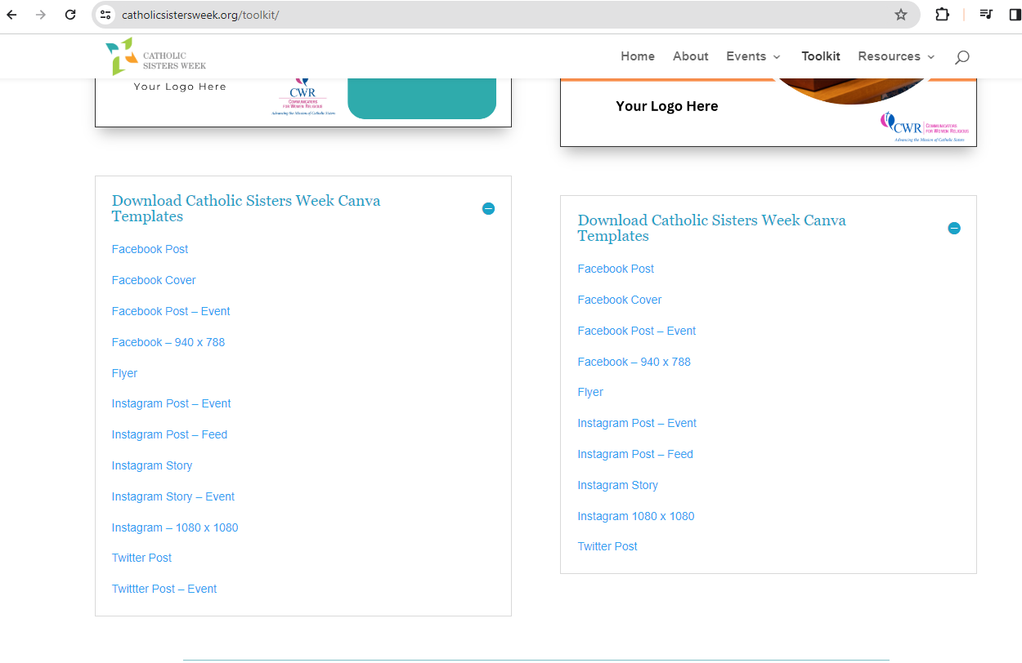
3
Click on the blue boxes to expand and reveal the different template options. Select your option by clicking on the link.
Left graphic theme:
Celebrating Traditions,
Changing The World.
Right graphic theme:
Caring for The Earth,
Caring for You.

Slide 5
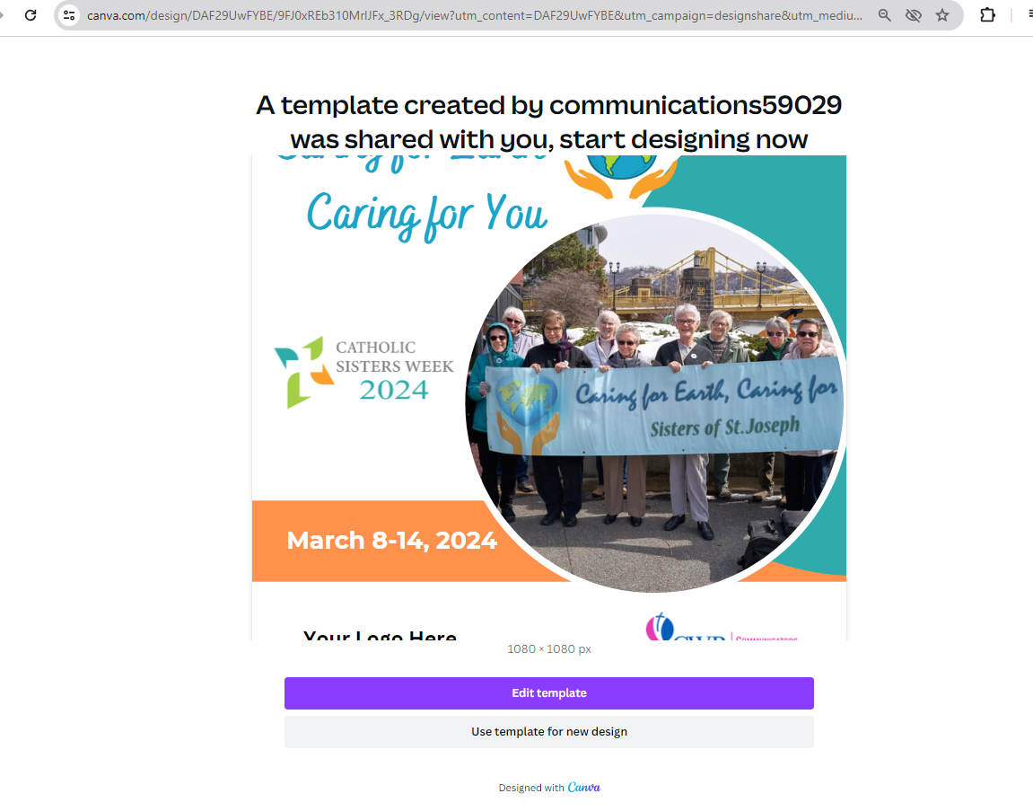
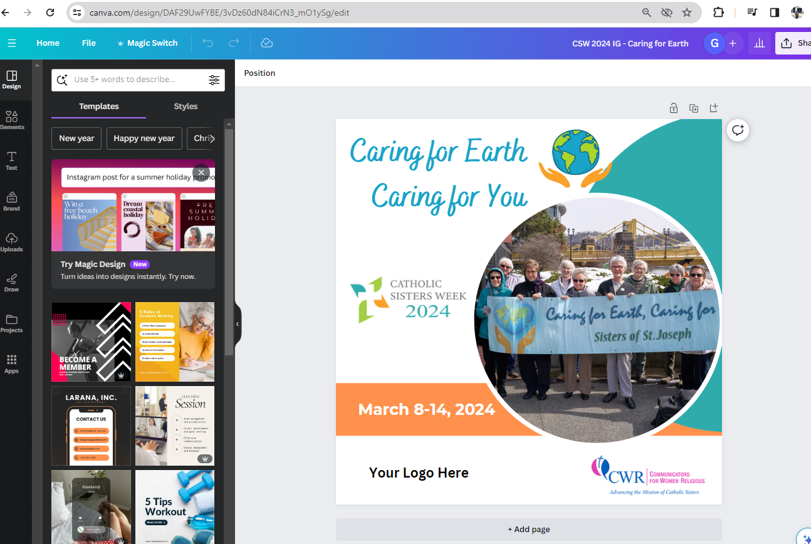
4
The link will bring you to a page like this. Click the purple “edit template” box.
You will then be brought into Canva to edit your copy of your chosen template.

Slide 6
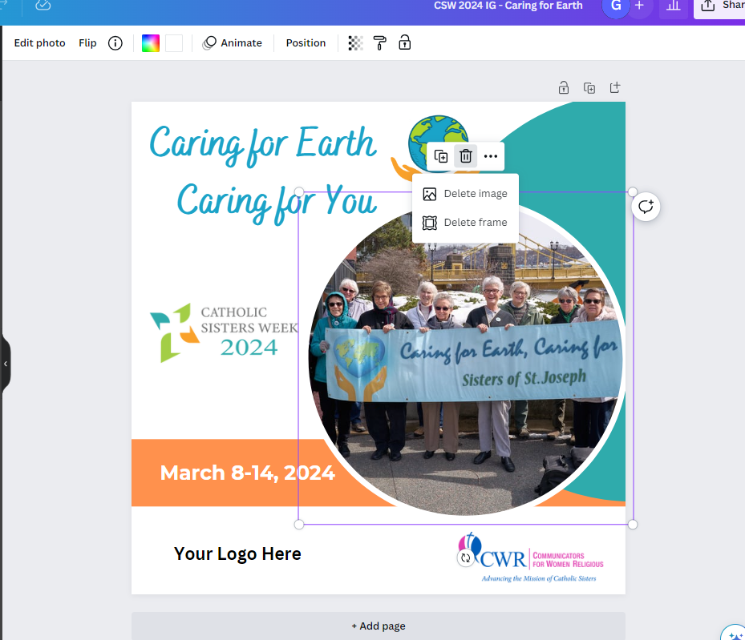

5
To begin customizing
the template start by deleting the included image.

Slide 7
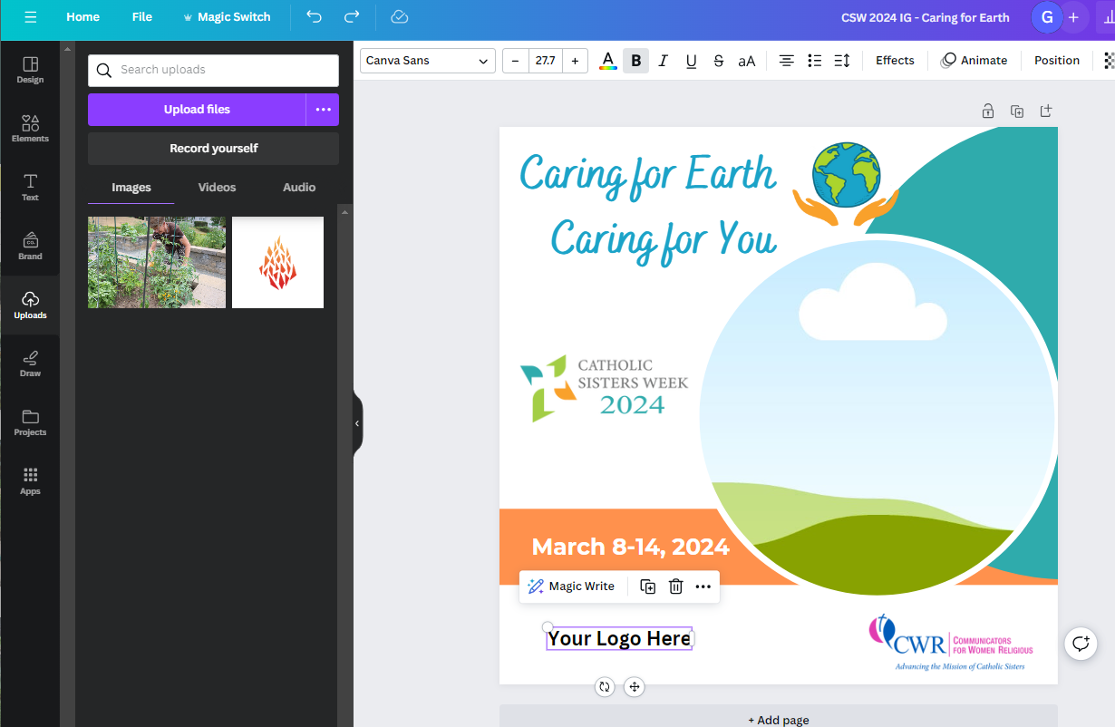
6
Do the Same with the text, reading “Your logo here”.
Personalize your template with your congregation’s logo.

Slide 8
7
On the left side bar, click on “uploads”.
Upload a photo and logo here by clicking “upload files”.

Slide 9
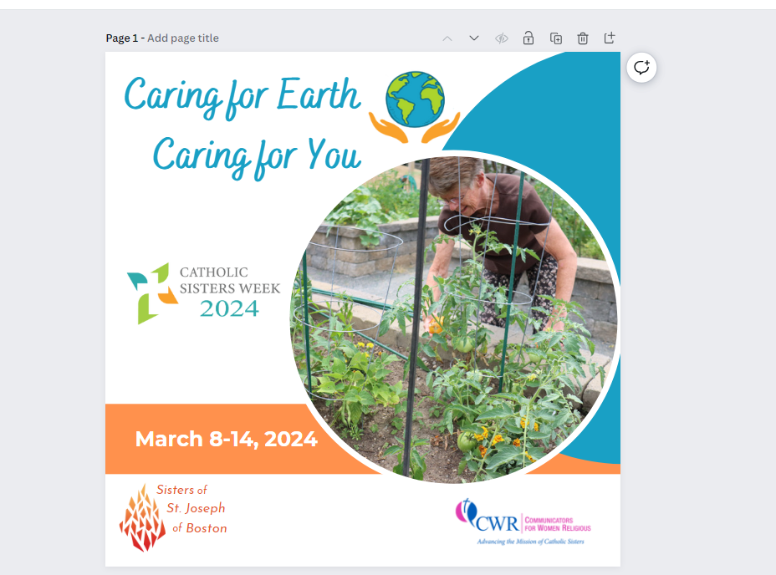
8
To finish customizing:
Place your chosen image in the circular frame.
Place your logo into the bottom left corner.

Slide 10
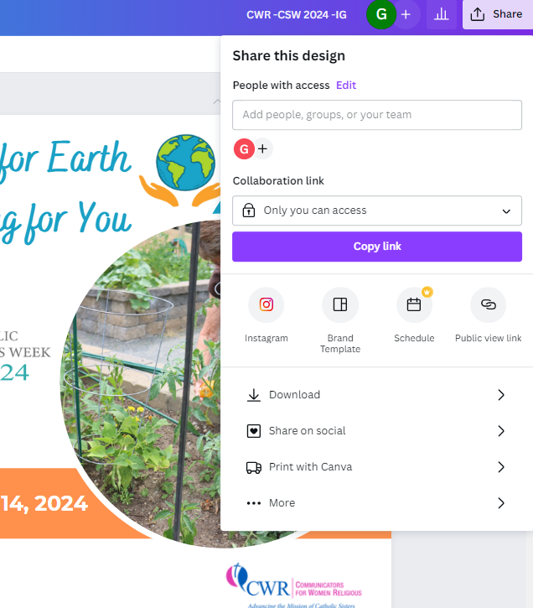
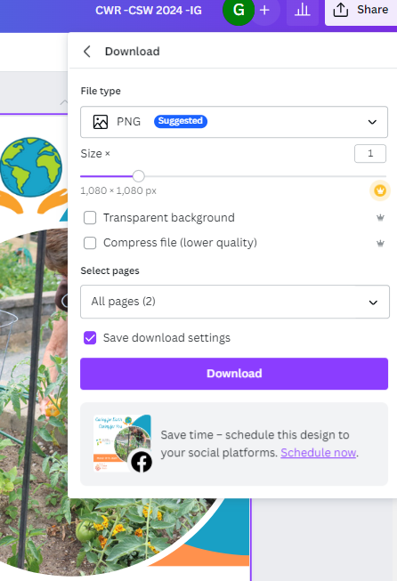
9
1. click on the “share” button
in the top right corner when ready to share
3. Save file
as PNG
2. Click “download”
4. Click “download”

Slide 11
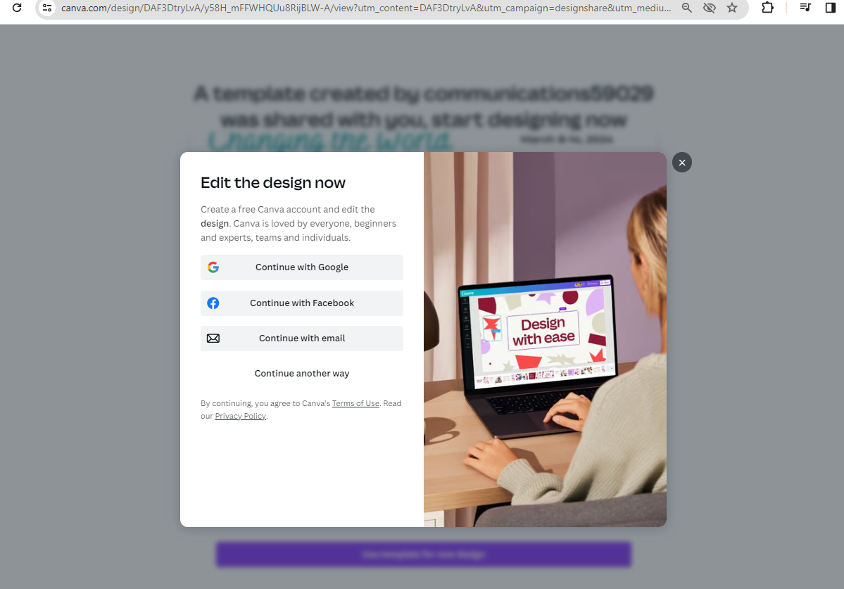
If you click on the purple “edit template” box, and are not brought directly into a new editable copy, you will want to open your own Canva account
if you don’t already have one.
https://www.canva.com/

Slide 12
Catholic SistersWeek 2024
Resource Walk-Through
LINK:
Catholic Sisters Week Toolkit

